Slide 1
City building
Juraj Brigljević i Mateo Dujić

Slide 2
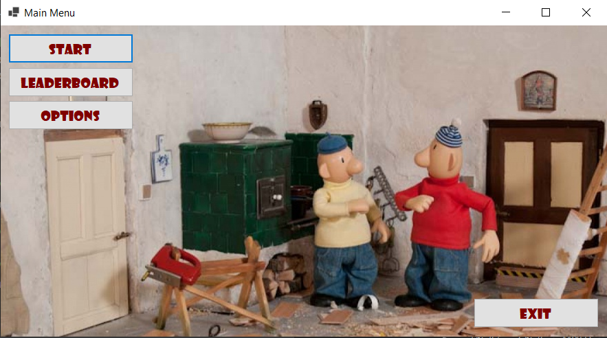
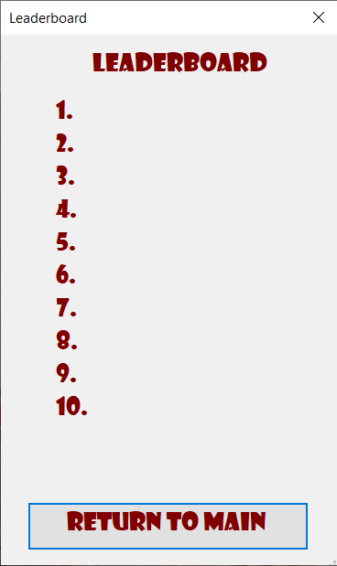
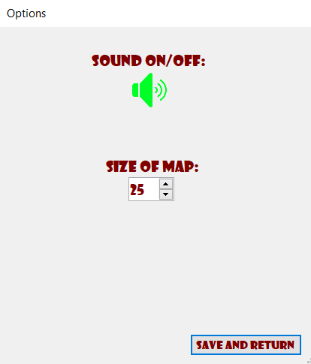
Game aspects
Main Menu
Leaderboard
Options
Game

Slide 3
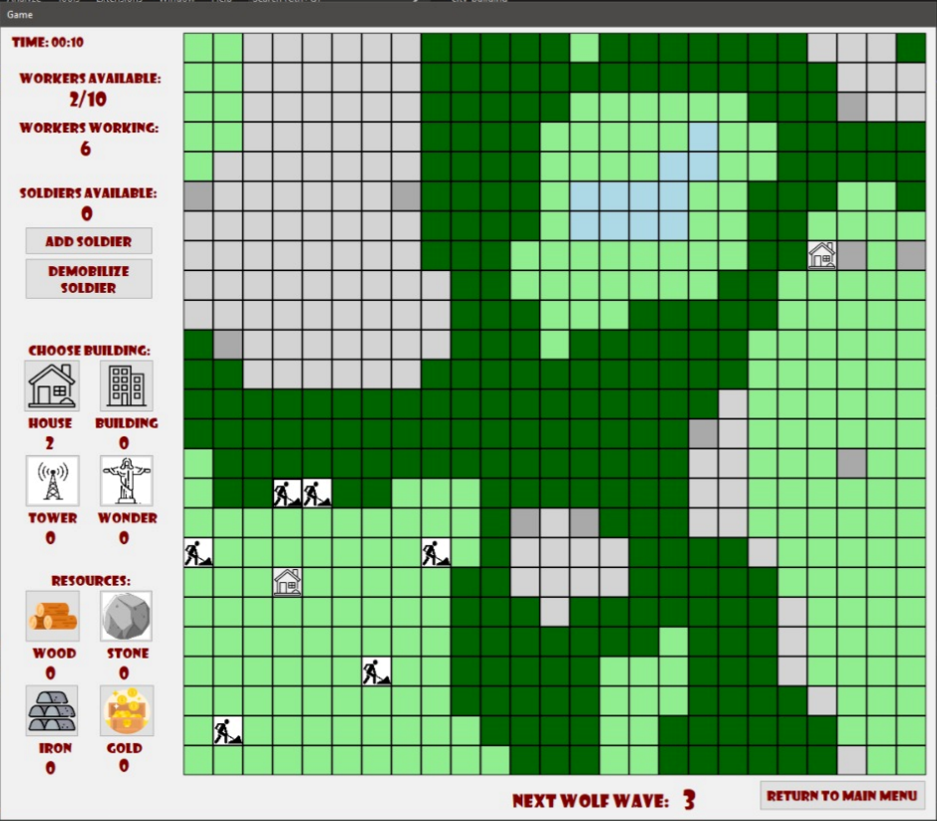
Game
STONE
WATER
Map
Perlin
Time (Game – tick)
Workers
Soldiers
Buildings
Resources
Wolves
IRON
FOREST
Workers harvesting/mining

Slide 4
How to play
While ( ! Wonder_built)
{
click somewhere on map;
Try to build/harvest/mine by using workers available using hotkeys (W, I, S, H, B, T, J) or clicking on buttons;
Build army to defend yourself from wolves;
Earn enough resources to build wonder as fast as possible;
}

Slide 5
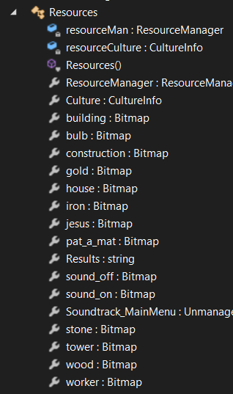
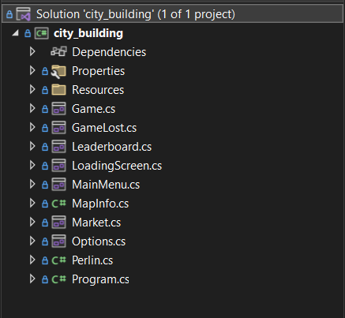
Code structure

Slide 6
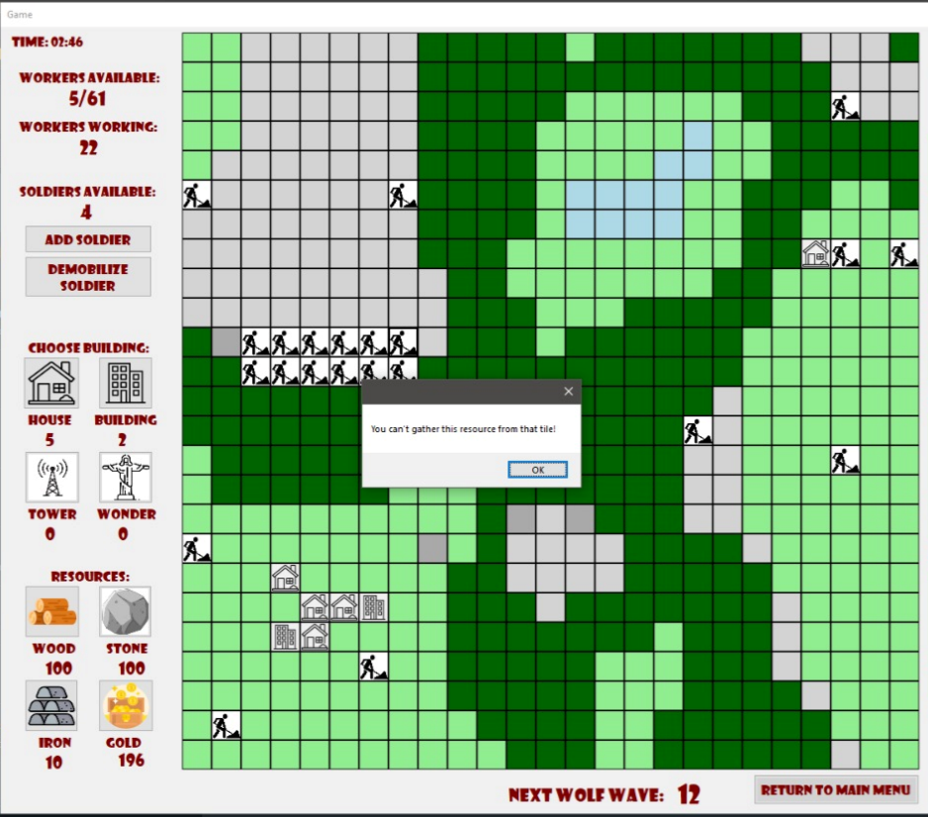
Map
Build on field only
Harvest/mine from
adequate place only

Slide 7

Map generation
Based on Perlin noise
Uses a height and temperature map to differentiate between water, land, forest and mountain
Iron is generated as random noise
A larger example of a map is on the next slide
2D Perlin noise map

Slide 8
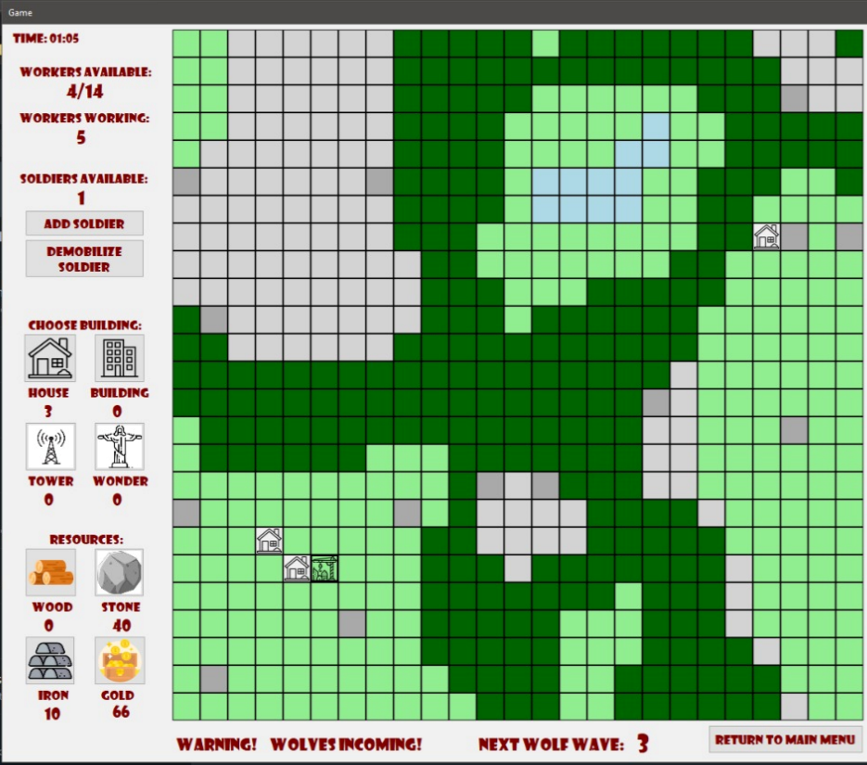
Workers
Harvest/mine
Build
Soldiers
Defend from wolves
Demobilize to workers

Slide 9
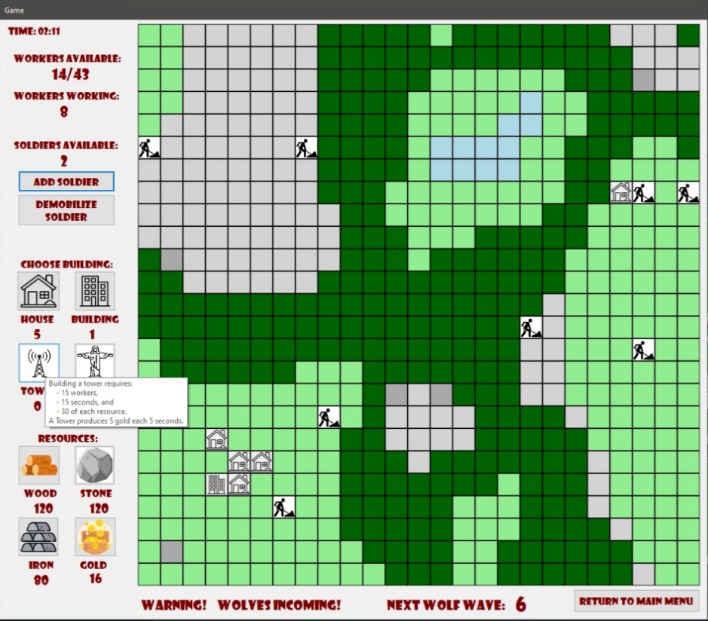
Buildings
House
Building
Tower
Wonder
Explanations
Tooltip

Slide 10
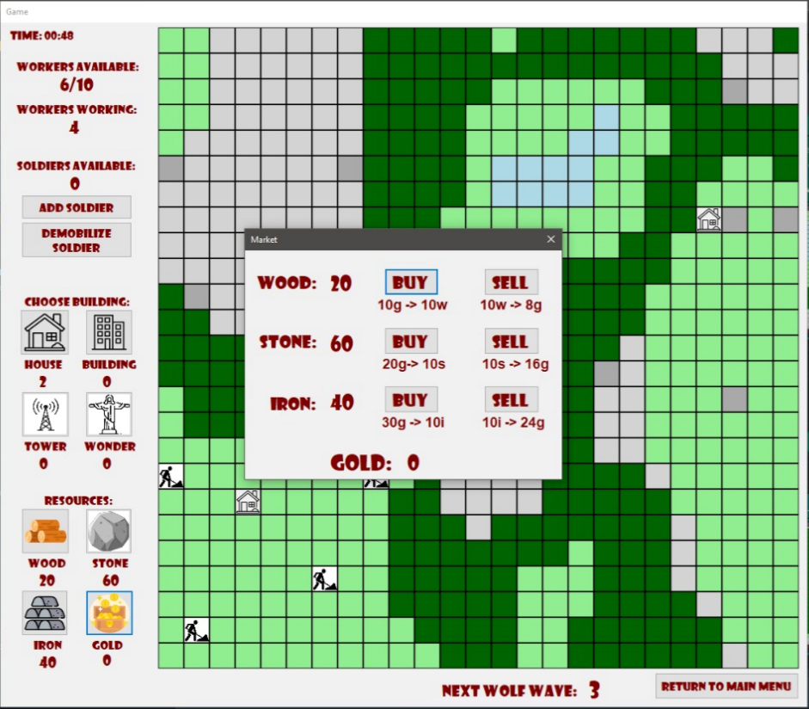
Resources
Wood
Stone
Iron
Gold
Market

Slide 11
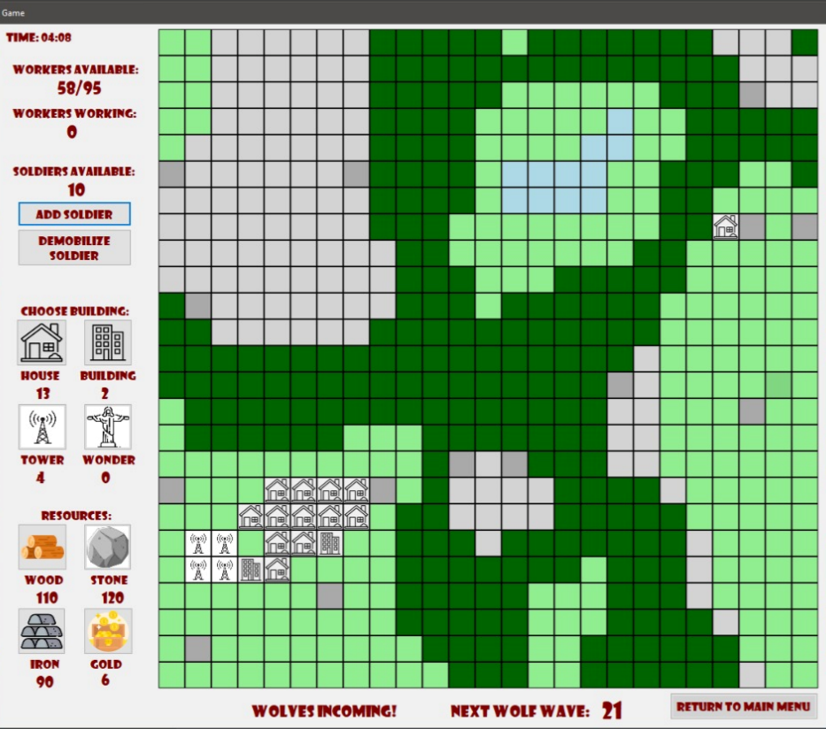
Wolves
Soldiers defend from
wolves
Wolves come in
waves

Slide 12
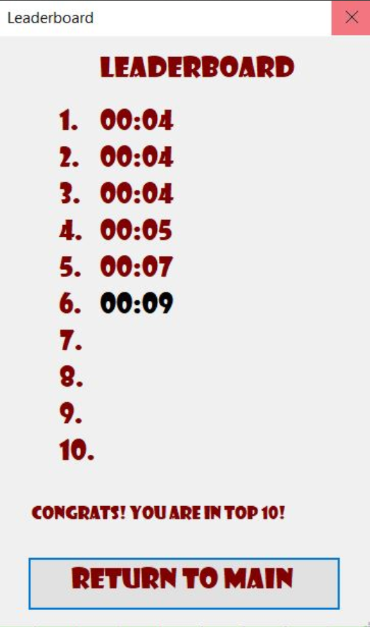
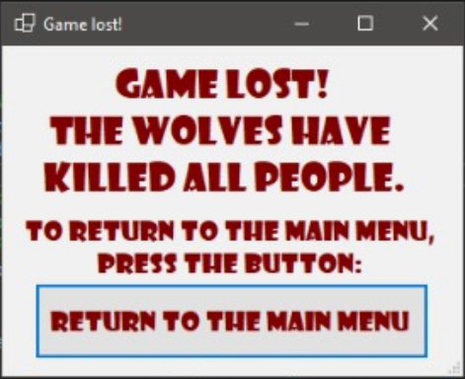
Finish
Win by building wonder (results from testing phase)
Lose by not surviving wolves

Slide 13
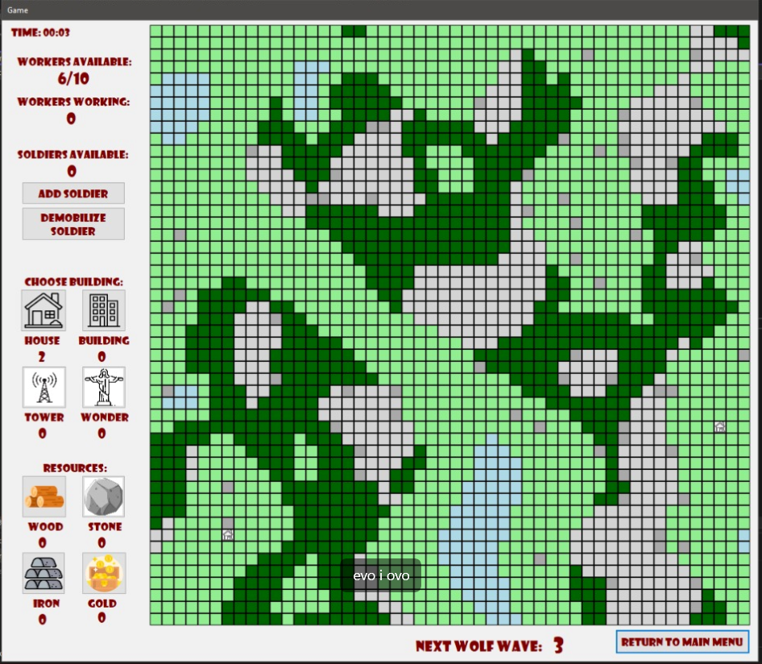
Bigger map

